Slide 1
BYOB
(blockchain, of course)

Slide 2
What is a blockchain?
“An immutable, sequential chain of records called blocks”
How are the blocks “chained?”
For our examples, we’re going to assume blocks contains a ledger, or a list of transactions between identities

Slide 3

Hashing
A hash function takes an input and produces an output
The output is the same for a given input
Eg: If you observe that $hash$(x) = y
then, every time you run $hash$(x), you will get y!

Slide 4

Hashing
y is easy to compute given x
You just run $hash$(x) and you get y
x is not easy to compute given y
The hash function cannot be reversed → ${hash}^{−1}$(y) = x does not exist

Slide 5
How does hashing relate to chaining blocks?
If you change x at all, hash(x) will look completely different!
Hash(‘aaaaa’) has no relationship to hash(‘aaaab’) you will see very different outputs when you put these 2 similar strings through a hash
Notes:
Demo in ipython
Sha1(‘aaaaa’.encode()).digest()

Slide 7
How does hashing relate to chaining blocks?
Immutability
If changing x drastically changes hash(x), we can have a guaranteed way of determining whether x was mutated
What if every block had the hash of the previous block included in its data?
If an attacker wanted to modify a tiny part of the 1st block, the hash of the 2nd block would change. If the hash of the 2nd block changed, the hash of the 3rd block (which contains the hash of the 2nd block) would change!

Slide 8
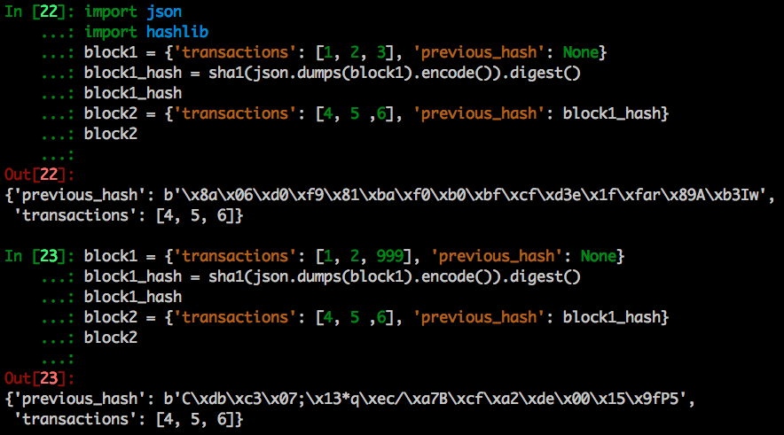

Slide 9
Review
Blockchain: immutable sequence of blocks containing transactions
Hashing functions: take an input and generate an output
Usually looks crazy, but you’ll get the same crazy looking thing for a given input you hash
Change the input, you’ll get a different output
Hashing + blockchains: hashing is used to check that no blocks in the past are modified
Include the previous block’s hash in the current block

Slide 10
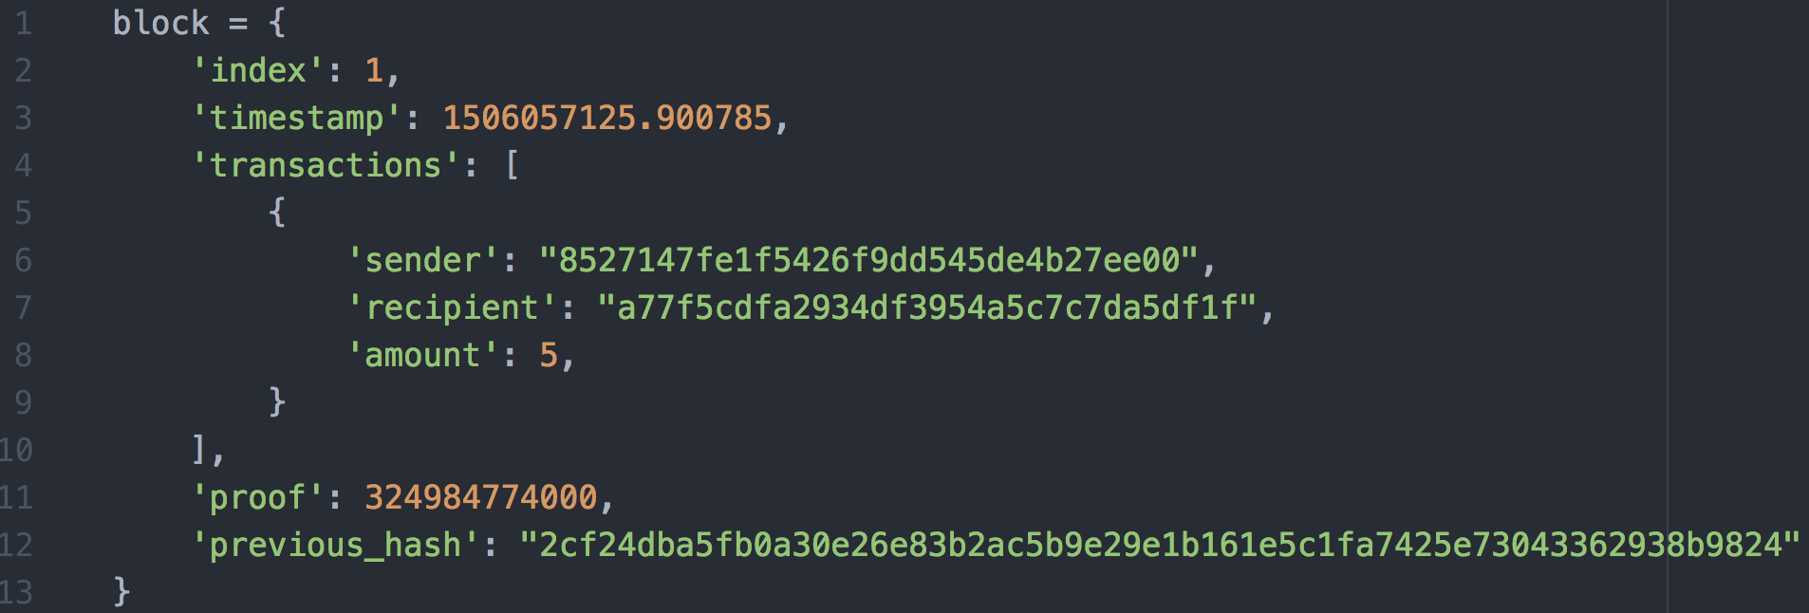
Our blockchain

Slide 11
Creating our first block
A block can contain many transactions
Before we create a block, we should build a list of transactions for that block
If we are running the blockchain on our node, we’ll want to add quite a few transactions to a block before creating it and appending it to the chain

Slide 12
Creating new blocks
First, we need a ‘genesis’ block
Add a ’proof’ to the genesis block, which is the result of mining which we’ll discuss in more detail later

Slide 13
New_block()
Builds a block by taking the
Current list of transactions
Current time
A ‘proof’ (still mysterious)
The hash of the previous block
Adds the block to the chain (simple append to a list)
Returns the block

Slide 14
New_transaction()
Builds a transaction by taking the
Sender
Recipient
Amount
Adds the transaction to the list of current transactions
Returns the index of the block that will hold the transaction

Slide 15
Hash()
Takes a block
Creates a string representation of that entire block
Returns the hash of the block

Slide 16
Last_block()
Returns the last block in the chain

Slide 17
How are blocks mined?

Slide 18
Proof of work
The goal is to find a number that solves a problem
Does this sound familiar to hashing?
Guessing what input you have to hash to get a given output is hard
Given y, finding a number x such that hash(x) = y is hard!
Just keep guessing

Slide 19

Proof of work (hashcash)
Used in Bitcoin
Set a rule that the hash of some number x multiplied by some other number y, must end in 0
$Hash(x ∗ y) = acb123…0$
Let’s see what this looks like in code, because we’re going to be using it to create a “proof of work.”

Slide 20
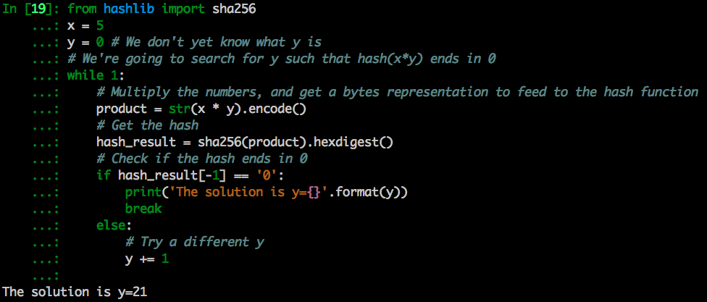
Proof of work (hashcash)

Slide 21

Proof of work Applied to blocks
Instead of x, let’s make the input to the hash function the last proof, the hash of the previous block, and a number ‘y’
We get the first 2 inputs from the last block in the chain that was mined
In order to ”mine” a block, we have to find a number ‘y’ such that $hash(last proof, last block hash, y ) = abc123…0$
To make “mining” more difficult, $hash(last proof, last block hash, y ) = abc123…0000$

Slide 22
Proof of work Applied to blocks
Miners prove they have done work by submitting a valid y (or “nonce”) to the network inside the block they submit
The network can easily verify that the particular ‘y’ that the node submits is correct... It just runs the hash function using ‘y’!

Slide 23
Implementing our proof of work
proof_of_work.py

Slide 24
Review of our blockchain’s functionality
Adding transactions to the transaction pool
Mining the next block
Calculating a proof
Consuming the transaction pool
Verifying a proof (verifying a mined block is legit)
We can run a node with these functions!

Slide 25
Our blockchain as an api

Slide 26
Blockchain as an api
The idea:
Run a node locally
Send transactions to that node
The node mines a block with transactions we’ve sent it
We can ask the node for the entire blockchain
Notes:
Go over server code

Slide 27
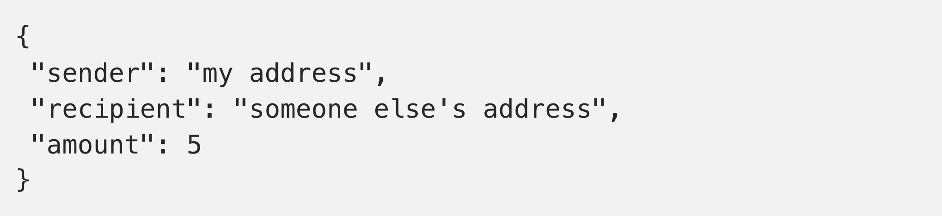
TRansactions endpoint
User of the blockchain can send a transaction to our node, using this endpoint
Send a POST to http://localhost:5000/transactions/new containing:
Notes:
Go over server code

Slide 28
Mining endpoint
How we tell the blockchain to mine a new block with all the current transactions
Usually, the node would constantly be trying to do this
Since our PoW algorithm makes it quick to mine blocks, we’ll only mine when we tell the node to mine
Send a POST to http://localhost:5000/mine
Notes:
Go over server code

Slide 29
Mining rewards
Note that our mining endpoint has code that adds a transaction for 1 “unit” to ourselves.
Nodes are allowed, by the protocol, to give themselves money out of thin air when they successfully mine!
These rewards are a unique transaction type called a “coinbase transaction”
Notes:
Go over server code

Slide 30
PARt II: Consensus

Slide 31
The byzantine generals problem
6 generals surround a city
They can send messengers to each other about what time they should attack
One general will betray them and offer a misleading attack time
How do you ensure no one listens to this general?
Notes:
Go over server code

Slide 32
Mostly there already...
Similar problem for us, we need many nodes in the network to agree on what the legitimate chain is
Proof of Work algorithm actually solves most of the consensus problem.
Need to ensure every honest node adds the exact same block to their local copy of the blockchain
Notes:
Go over server code

Slide 33
Example: double spending
Consider: no PoW, blocks can be mined instantly
Alice has 10 coins
Alice sends node A a transaction saying she sent 10 coins to Bob
Alice sends node B a transaction saying she sent 10 coins to Charlie
Nodes would be able to create tons of blocks that looked different
Network would be flooded
Notes:
Go over server code

Slide 34
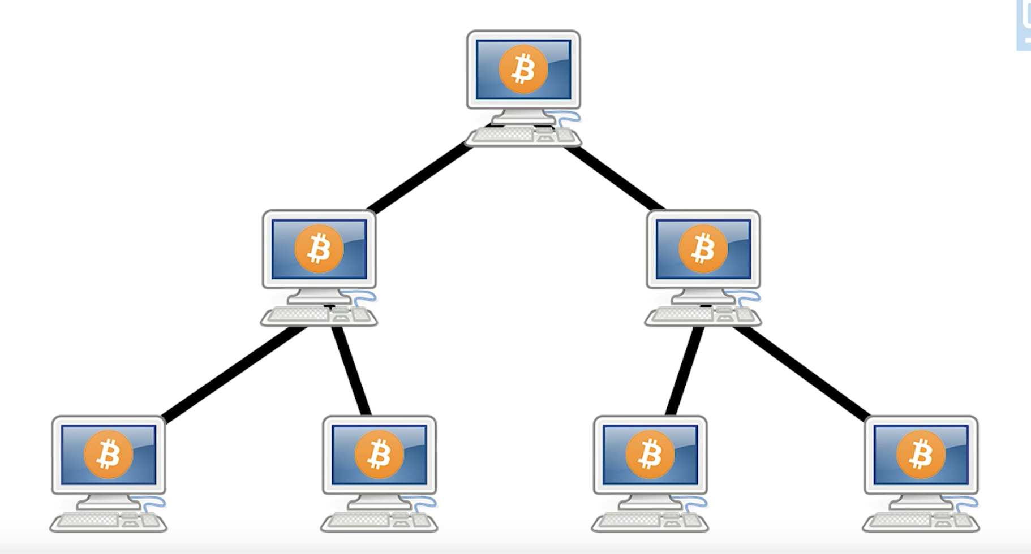
Example: double spending
Now add PoW
Nodes race to complete the next block
The first node to successfully create the block broadcasts it to neighbors
Neighbors quickly check for a legitimate proof before sending it to other neighbors
Attackers can’t spam the network with incorrect blocks
Alice can’t double spend, because one of her transactions will be in the next accepted block, but not the other!
Notes:
Go over server code

Slide 35
Consensus: longest chain
Node A reaches out to nodes B and C to get the current chain
B’s chain = 15 blocks
C’s chain = 16 blocks (blocks 14 and 15 are different than B’s)
Notes:
Go over server code

Slide 36
longest chain: implementation
valid_chain()
Go through every block in the chain and check its hash
Fast!
Useful when querying other nodes for the blockchain
resolve_conflicts()
Downloads every neighboring node’s chain to see if their chain is longer
Also validates that chain
Replace our chain with the longest one if necessary
Notes:
Go over server code

Slide 37
longest chain: Adding to the api
/nodes/register
Adds node(s) to the node’s list of neighbors
/nodes/resolve
Tells the node the call our resolve_chain() function and check to see if neighbor’s chains are longer
Notes:
Go over server code

Slide 38
Testing the chain!
Spin up a couple nodes
Open 2 terminal sessions and run
`python3 server.py 5000`
`python3 server.py 5001`
Postman
Click ‘import’ on top left
Paste url for the postman collection from the README
You’ll see a bunch of GET/POST requests we can send to our 2 nodes running our blockchain. I’ve set them up already, so you can just send them
Notes:
Go over server code

Slide 39
Testing the chain!
Look at the 2 terminals you opened up while running these commands. The nodes should log what is going on, and send you a message in the response
First, register node 0 with node 1 and visa versa (there is a command for each)
Click ”transaction on node 0” and click on the ”body” tab in postman. Put in a sender, recipient, and amount– hit send!
Mine a block on node 0 and check out the response, you can see your transaction was included in the block and the block has a proof
Notes:
Go over server code

Slide 40
Testing the chain!
Now resolve node 1 so that node 1 downloads and resolves node 0’s chain
Remember that node 1 does validation of the entire chain each time you ask it to resolve
You should see “our chain was replaced” along with the chain with your transaction from node 0
Notes:
Go over server code

Slide 41
Conclusion
What incentivizes miners when the maximum number of coins has been mined?
How can we implement a way for transactions to be signed. IE:
How can we make it so that I can’t spend someone else’s money just be sending a transaction?
What happens when computers get really good at computing hashes?
Notes:
Go over server code

